Slide 1
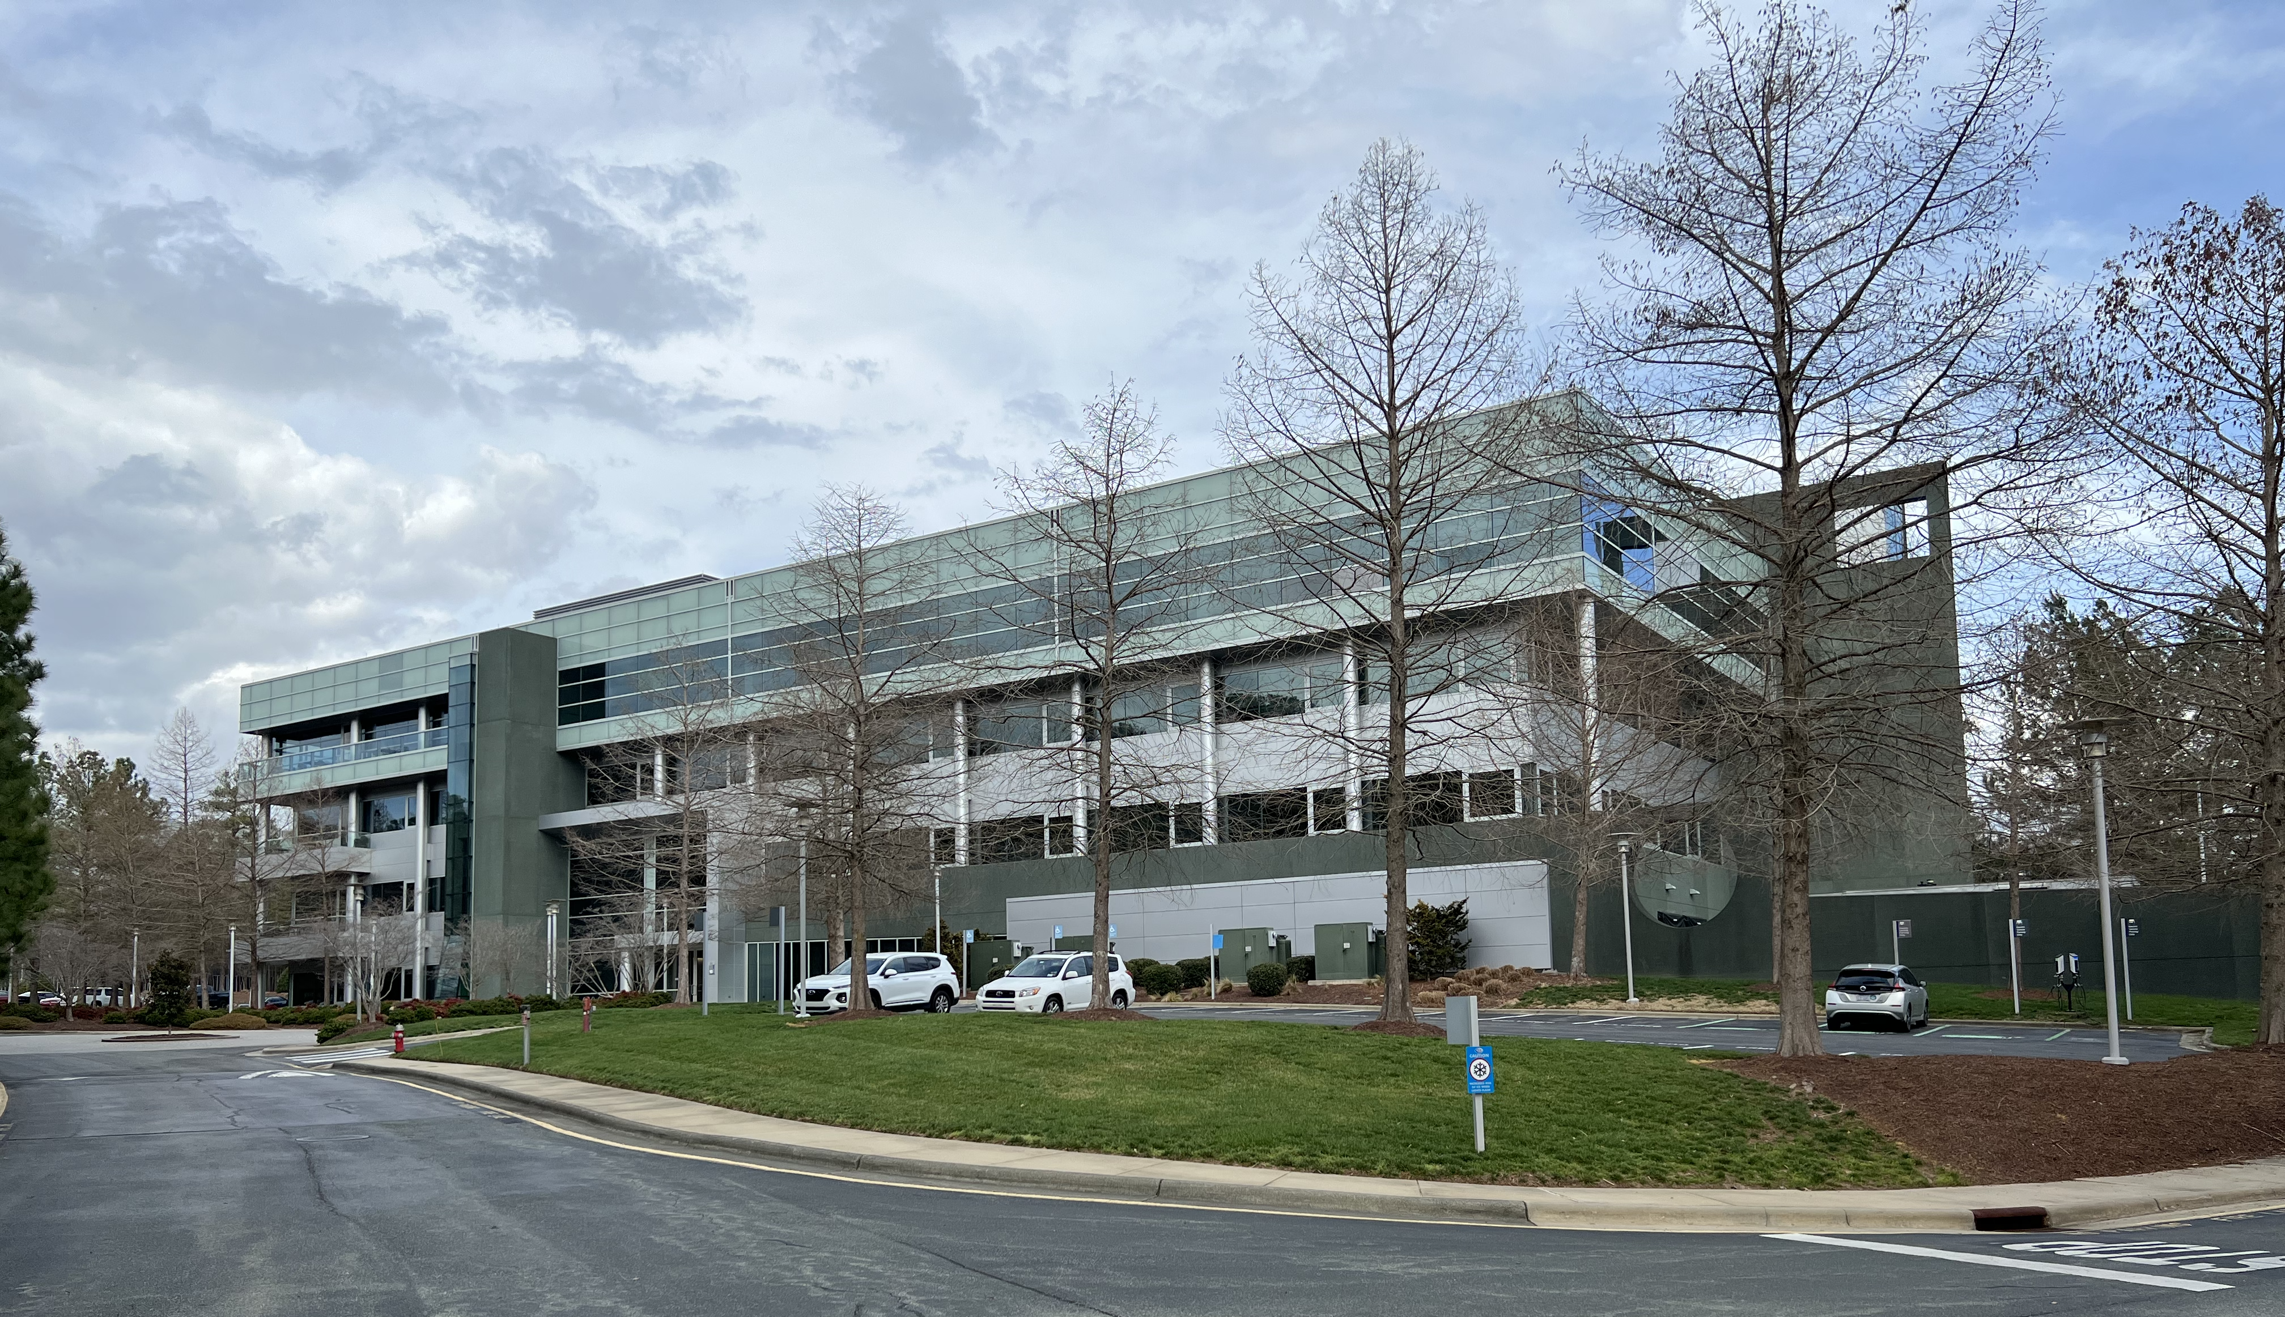

RTP10 Total: 35
Floor 4: 11
Floor 3: 4
Floor 2: 13
Floor 1: 7
Data as-of: Mon Mar 7 01:40:10 PM EST 2022

